Slide 1
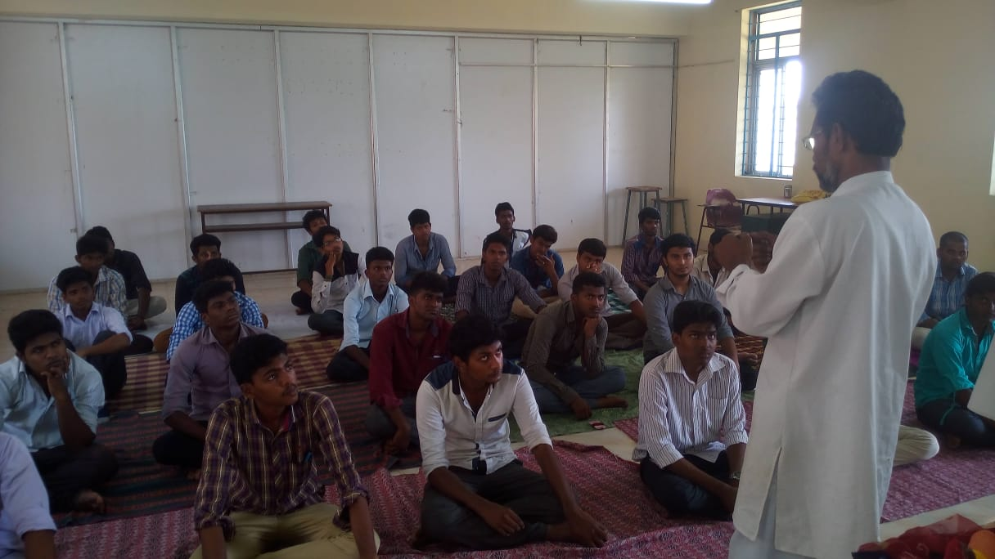
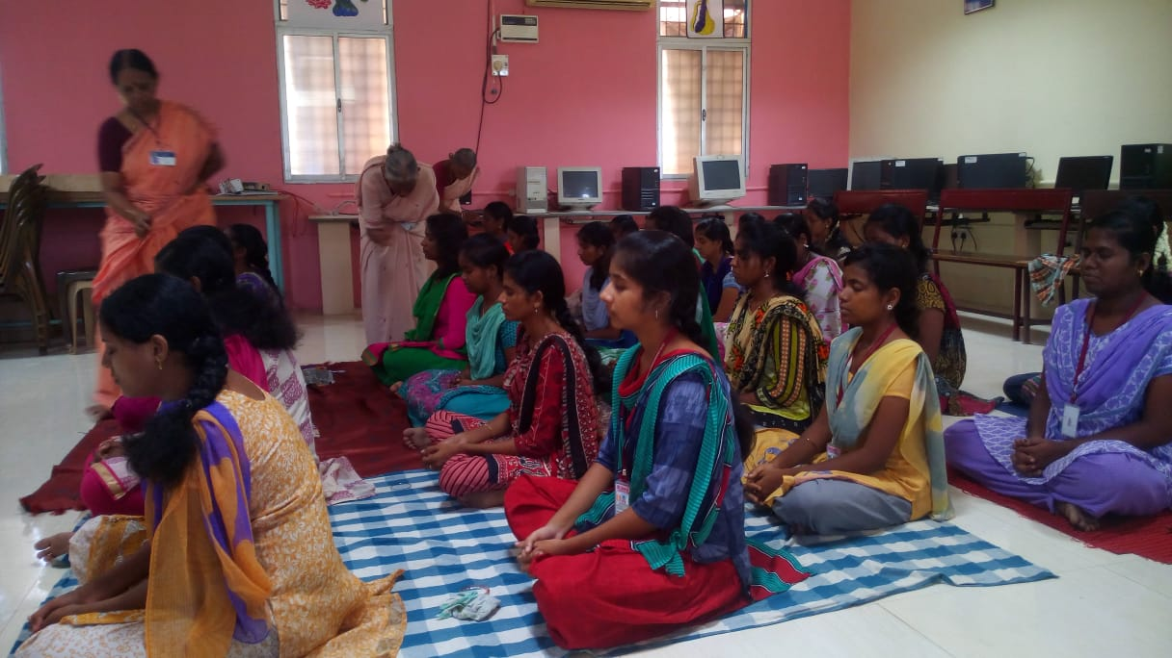
JAYA ENGINEERING COLLEGE
CTH Road,Prakash Nagar,Thiruninravur,
Chennai-602024
Yoga Club
organized
Yoga for Youth Empowerment
25th - 30 ^{th} April 2016
Jaya Engineering College -Yoga Club Organized yoga workshop on Yoga for Youth Empowerment from 25th to. 30th April 2016. Breathing exercise, simple exercises, meditation and kayakalpa yoga was taught to the students during the workshop. Experts from sky Yoga villivakkam trained the students during the workshop.

